Slide 1
Recursion
Week 4, Summer 2024. 7/8 (Mon)
Lecture 11

Slide 2
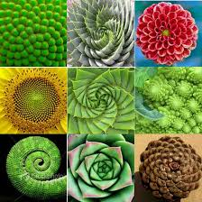

Recursion
M. C. Escher : Drawing Hands

Slide 3
Announcements
HW04, Lab04 due today (11:59 PM PST)
“(Urgent) Midterm Exam Scheduling” due TOMORROW (7/9 11:59 PM PST)
HW05, Lab05 due 7/10 (Wed)
Project01 (“Maps”) is out!
Checkpoint: due 7/10 (Wed)
Full project: due 7/18
New weekly course survey out in Gradescope (optional, +0.5 extra credit pts)

Slide 4
Announcements: Midterm scheduling!
IMPORTANT: Complete the “Midterm Exam Scheduling” form on Gradescope
Due: Tuesday July 9th, 11:59 PM PST
It is required that every student fill this out. If you don’t fill this out, you will risk missing the midterm.
Please, please do this ASAP! Thank you!
(DSP students with +50% exam time) We have sent you a Google Form to schedule your exam. Please fill this out ASAP!
But, you should still fill out the above Gradescope “Midterm Exam Scheduling” form as well!

Slide 5
Midterm content
Midterm will cover content from start of course up to (and including) OOP+Inheritance, aka:
Start (inclusive): Lecture 01: “Welcome & Intro” (6/17)
End (inclusive): Lecture 15: “OOP – Inheritance” (7/15)
Midterm will be done through Zoom + Gradescope
Study tip: past C88C exams can be found here: https://c88c.org/sp24/articles/resources.html#past-midterms
Take a look to get a sense of what C88C exams tend to look like. (I highly, highly encourage this)
“Be prepared” – Boy Scouts
“Luck is when preparation meets opportunity” – Roman philosopher Seneca

Slide 6
Midterm logistics
The midterm will be held over Zoom + Gradescope
You must have your camera + screen sharing on during the entire exam, and we will be doing screen+camera recording.
You must take the exam in a quiet room with no other students present
Things to bring to the exam (and nothing else!):
Photo ID. Ideally your UCB student ID, but anything with your name + photo is fine, eg: Passport, driver’s license, etc.
(Optional) Five (5) pages of handwritten (not typed!) notes
(Optional, recommended) Additional blank scratch paper, pencil/pen/eraser.
We will provide everyone with a 1-2 page digital PDF of additional reference
Other than the above notes, the exam will be closed book, closed notes.
(For more info, stay tuned for an Ed post)

Slide 7
Lecture overview
Recursion
Recursion in Python
Iteration (for/while) vs recursion
Identifying recursive structure of problems

Slide 8
(Optional) vee / Fractals
python3 –i 11-Recursion.py
This uses Turtle Graphics.
The turtle module is really cool, but not something you need to learn
vee is the one recursive problem that doesn't have a base case
But fractals in general are a fun way to visualize self-similar structures
Use the following keys to play with the demo
Space to draw
C to Clear
Up to add "vee" to the functions list
Down to remove the "vee" functions from the list.
Some cool variations on vee, seen in Snap! (the language of CS10)
More Fractals

Slide 9
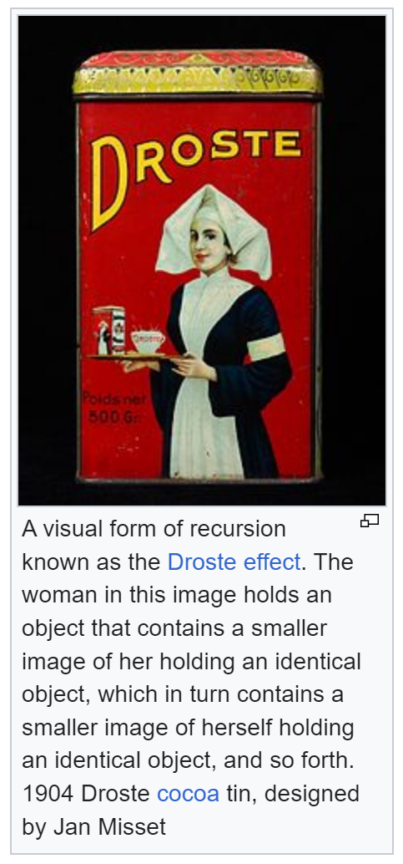
Recursion: a broad definition
Recursion occurs when the definition of a concept or process depends on a simpler or previous version of itself. (from: Wikipedia)

Slide 10
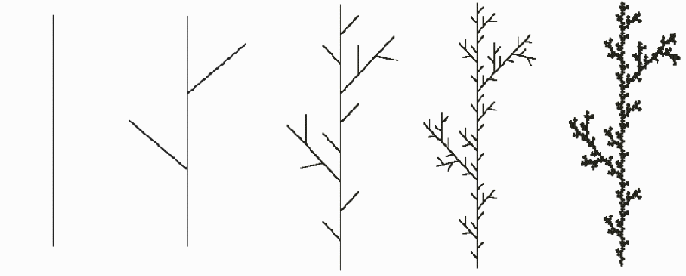
Recursion application: plants/trees
Fun application: artificial plants/trees built via recursively-defined rules
Source: http://guyhaas.com/bfoit/itp/RecursionInNature/RecursionInNature.html
(Step 1) Start with a line segment.
(Step 2) Replace the line segment with 5 line segments as pictured, each 1/3 the length of the original.
(Step N) Replace each segment in step n-1 with a reduced copy of the step n-1 figure.

Slide 11
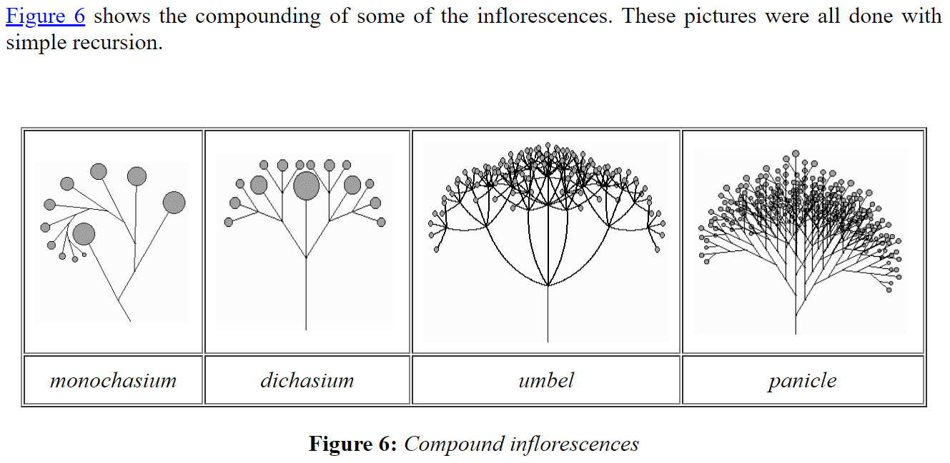
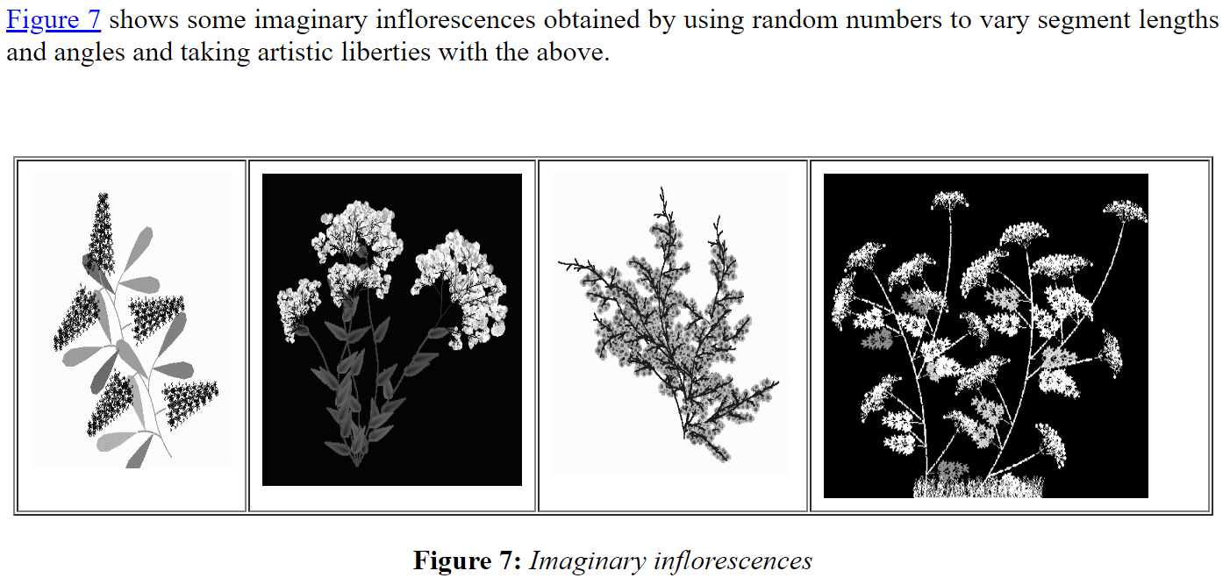
Recursion application: plants/trees
Source: http://guyhaas.com/bfoit/itp/RecursionInNature/RecursionInNature.html

Slide 12
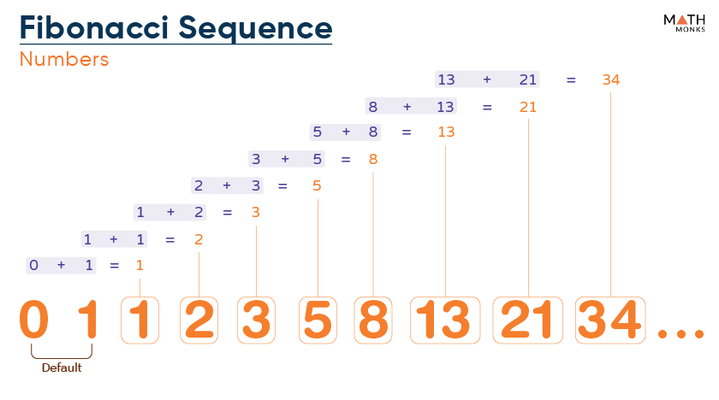
Recursion in Computer Science / Math
Sometimes, a problem or process is easiest to describe via a recursive definition.
Fibonacci sequence: 0, 1, 1, 2, 3, 5, 8, 13, 21, 34, …
Recursive definition: Fibonacci(n) = Fibonacci(n – 1) + Fibonacci(n – 2)
Source: https://mathmonks.com/fibonacci-sequence

Slide 13
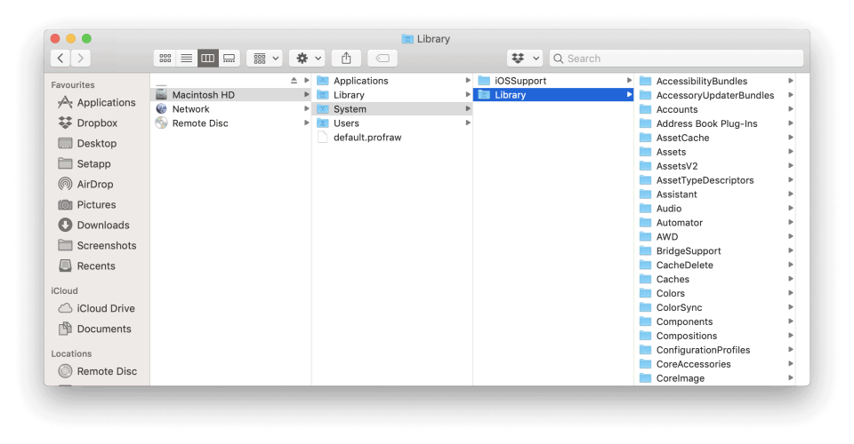
Recursion in Computer Science / Math
Searching for a file in a file system
To find a file: starting from the current directory, examine the files in the current directory.
If there is another directory, then (recursively) search for the file in that subdirectory.
In that subdirectory: if there is a subdirectory, search for the file in that subdirectory
…and so on…
Source: https://mac-optimization.bestreviews.net/how-to-restore-system-files-on-macos/
A Folder contains:
Files
Folders
Recursion!

Slide 14
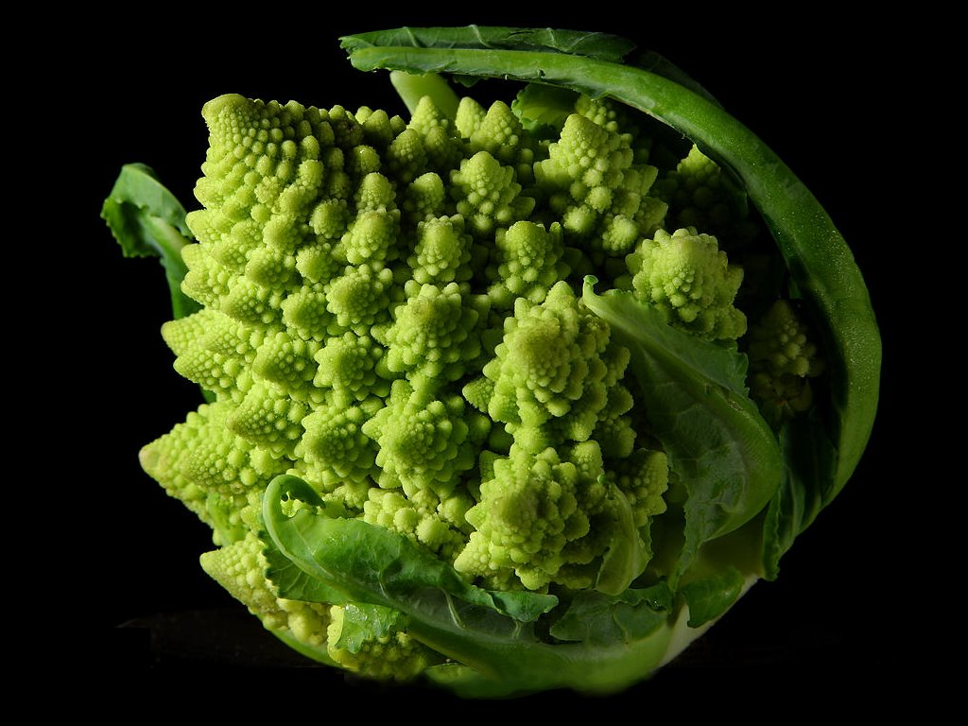
Recursion In Practice
Key idea: A recursive function operates by solving smaller sub-problems
“Smaller sub-problems” -> recursive function calls
Compared to a for-loop, while loop, we will not directly specify how many times we need to make a function call.

Slide 15
Toy Example: Countdown
A recursive function calls itself in its body:
def countdown(n):
if n == 0:
print('Blastoff!')
else:
print(n)
countdown(n - 1)
>>> countdown(5)
5
4
3
2
1
Blastoff
Recursive call!

Slide 16
The Recursive Process
Recursive solutions involve two major parts:
Base case(s), the problem is simple enough to be solved directly
Recursive case(s). A recursive case has three components:
Divide the current problem into one or more simpler or smaller parts
Invoke the function (recursively) on each part, and
Combine the solutions of the parts into a solution for the current problem.

Slide 17
Recursion

Slide 18
Learning Objectives
Compare Recursion and Iteration to each other
Translate some simple functions from one method to another
Write a recursive function
Understand the base case and a recursive case

Slide 19
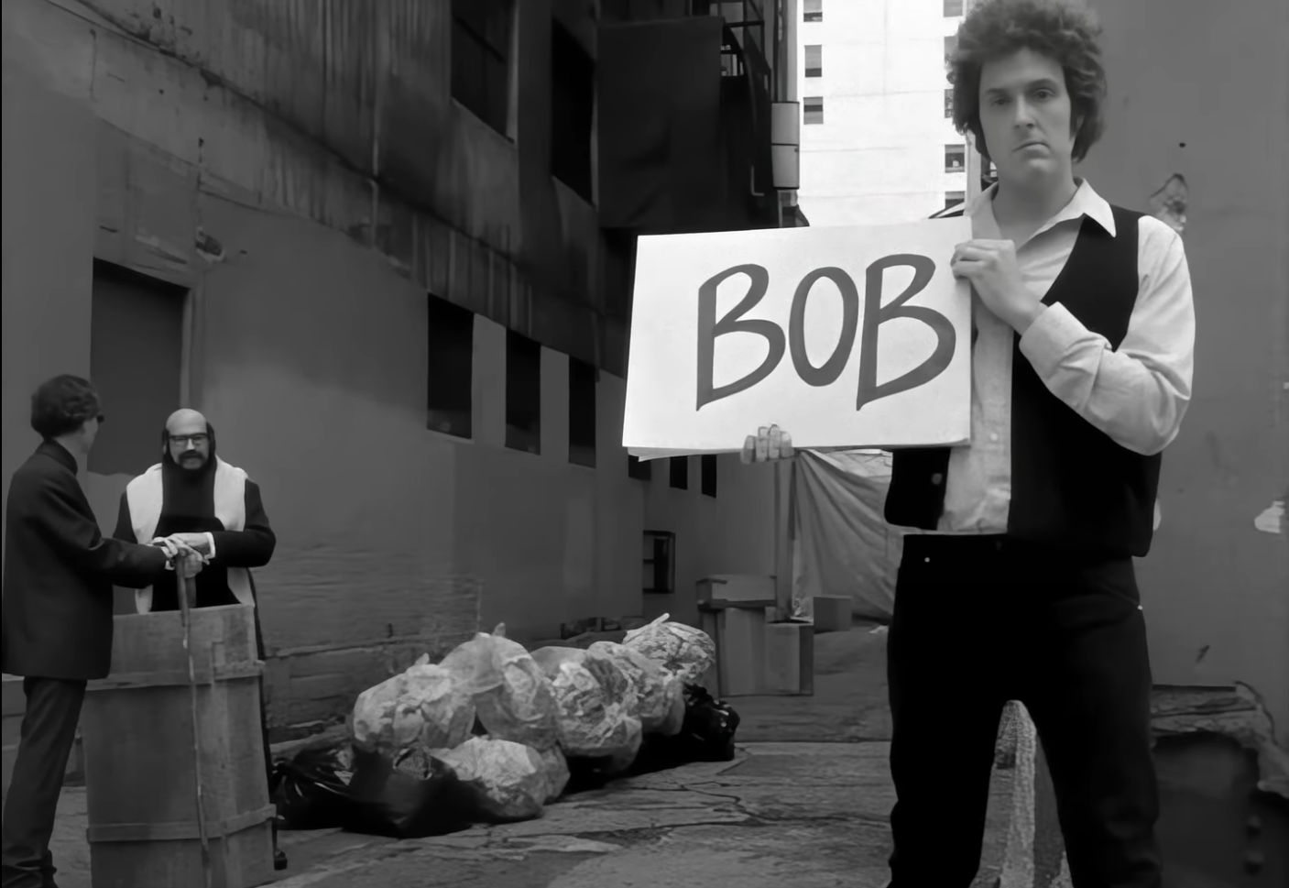
Example: Palindromes
Definition: Palindromes are the same word forwards and backwards.
Examples:
C88C
racecar
LOL
a man a plan a canal panama
aibohphobia 😈
The fear of palindromes.
https://czechtheworld.com/best-palindromes/#palindrome-words
“Bob” – Weird Al Yankovic
(Lyrics contain only palindromes!)
“I, man, am Regal, a German am I
Never odd or even
If I had a Hi-Fi
Madam, I'm Adam
Too hot to hoot”

Slide 20
Example: Palindromes
Palindromes are the same word forwards and backwards.
How to define an `is_palindrome(word)` function?
One way: check if the reversed string is the same as the input string
def is_palindrome(input_str):
return input_str == reverse_str(input_str)
>>> is_palindrome("too hot to hoot")
True
>>> is_palindrome("meow")
False

Slide 21
Example: Reverse (iteratively)
Question: How to define `reverse_str()` via iteration (for/while)?
Notably, let’s not use the [::-1] shortcut. For practice, let’s implement it once with a for loop, and another with a while loop.
def reverse_str_for(input_str):
# FILL ME IN
def reverse_str_while(input_str):
"""
>>> reverse_str_while('hello')
'olleh'
""“
# FILL ME IN

Slide 22
Example: Reverse (iteratively)
Question: How to define `reverse_str()` via iteration (for/while)?
Notably, let’s not use the [::-1] shortcut. For practice, let’s implement it once with a for loop, and another with a while loop.
def reverse_str_for(s):
result = ''
for letter in s:
result = letter + result
return result
def reverse_str_while(s):
"""
>>> reverse_str_while('hello')
'olleh'
"""
result = ''
while s:
first = s[0]
s = s[1:]
result = first + result
return result
Note: there are many other ways to do this. For instance, in the while-loop implementation we could have iterated backwards over the string via indexing.

Slide 23
Example: Reverse (recursively)
Question: How to define `reverse_str()` as a recursive process in the following manner?
"hello" -> "olleh"
Base case(s), the problem is simple enough to be solved directly
Recursive case(s). A recursive case has three components:
Divide the current problem into one or more simpler or smaller parts
Invoke the function (recursively) on each part, and
Combine the solutions of the parts into a solution for the current problem.
(Hint) Recursive structure of problem:
If I reversed the substring “ello” -> “olle”, how do I use this partial result “olle” to solve my current problem of reversing “hello”?
Answer: “olle” + “h” -> “olleh”, or in code:
reverse_str(“hello”) is reverse_str(“ello”) + “h”
Or, more generally:
reverse_str(s) is reverse_str(s[1:]) + s[0]
Solve smaller problem (Divide+Invoke)
Combine smaller solution to solve the current problem

Slide 24
Example: Reverse (recursively)
Question: How to define `reverse_str()` as a recursive process in the following manner?
"hello" -> "olleh"
Base case(s), the problem is simple enough to be solved directly
Recursive case(s). A recursive case has three components:
Divide the current problem into one or more simpler or smaller parts
Invoke the function (recursively) on each part, and
Combine the solutions of the parts into a solution for the current problem.
(Hint) Base cases
What are the simplest (“trivial”) strings to reverse?
Empty string, string with one character
reverse_str(“”) -> “”
reverse_str(“o”) -> “o”

Slide 25
Example: Reverse (recursively)
Now that we’ve identified the recursive process for string reversal, let’s translate it into Python code
"hello" -> "olleh"
Base case(s), the problem is simple enough to be solved directly
Recursive case(s). A recursive case has three components:
Divide the current problem into one or more simpler or smaller parts
Invoke the function (recursively) on each part, and
Combine the solutions of the parts into a solution for the current problem.
Base cases
What are the simplest (“trivial”) strings to reverse?
reverse_str(“”) -> “”
reverse_str(“o”) -> “o”
Recursive structure
“olle” + “h” -> “olleh”, or in code:
reverse_str(“hello”) is reverse_str(“ello”) + “h”
Or, more generally:
reverse_str(s) is reverse_str(s[1:]) + s[0]

Slide 26
Example: Reverse (recursively)
Now that we’ve identified the recursive process for string reversal, let’s translate it into Python code
"hello" -> "olleh"
Base cases
What are the simplest (“trivial”) strings to reverse?
reverse_str(“”) -> “”
reverse_str(“o”) -> “o”
def reverse_str(s):
# Base cases
# FILL ME IN
# Recursive cases
# FILL ME IN
Recursive structure
“olle” + “h” -> “olleh”, or in code:
reverse_str(“hello”) is reverse_str(“ello”) + “h”
Or, more generally:
reverse_str(s) is reverse_str(s[1:]) + s[0]
Question: how to fill in the base cases?

Slide 27
Example: Reverse (recursively)
Now that we’ve identified the recursive process for string reversal, let’s translate it into Python code
"hello" -> "olleh"
Base cases
What are the simplest (“trivial”) strings to reverse?
reverse_str(“”) -> “”
reverse_str(“o”) -> “o”
def reverse_str(s):
# Base cases
if len(s) == 0 or len(s == 1):
return s
# Recursive cases
# FILL ME IN
Recursive structure
“olle” + “h” -> “olleh”, or in code:
reverse_str(“hello”) is reverse_str(“ello”) + “h”
Or, more generally:
reverse_str(s) is reverse_str(s[1:]) + s[0]
Question: how to fill in the recursive cases?

Slide 28
Example: Reverse (recursively)
Now that we’ve identified the recursive process for string reversal, let’s translate it into Python code
"hello" -> "olleh"
Base cases
What are the simplest (“trivial”) strings to reverse?
reverse_str(“”) -> “”
reverse_str(“o”) -> “o”
def reverse_str(s):
# Base cases
if len(s) == 0 or len(s) == 1:
return s
# Recursive cases
return reverse_str(s[1:]) + s[0]
Recursive structure
“olle” + “h” -> “olleh”, or in code:
reverse_str(“hello”) is reverse_str(“ello”) + “h”
Or, more generally:
reverse_str(s) is reverse_str(s[1:]) + s[0]

Slide 29
How does the recursion work?
Our algorithm in words:
Take the first letter, put it at the end
The beginning of the string is the reverse of the rest.
reverse('ABC')
→ reverse('BC') + 'A'
→ reverse('C') + 'B' + 'A
→ 'C' + 'B' + 'A
→ 'CBA'
def reverse_str(s):
# Base cases
if len(s) == 0 or len(s) == 1:
return s
# Recursive cases
return reverse_str(s[1:]) + s[0]

Slide 30
Iteration vs Recursion: Sum Numbers
Iteratively (For loop):
def sum_for(n):
s = 0
for i in range(0, n + 1):
s = s + i
return s
Iteratively (While loop):
def sum_while(n):
s = 0
i = 0
while i < n:
i = i + 1
s = s + i
return s
Recursively
def sum_recurse(n):
if n == 0:
return 0
return n + sum_recurse(n - 1)

Slide 31
Aside: closed form solutions (Math)
Sometimes, a recursive math function will have a closed form solution!
In this class: even if you know the closed-form solution, and we ask you to implement it recursively: don’t just use the closed-form solution ☺
def sum_recurse(n):
if n == 0:
return 0
return n + sum_recurse(n - 1)
def sum_closed_form(n):
return (n * (n + 1)) / 2
def fib(n):
if n <= 1:
return n
return fib(n - 1) + fib(n - 2)
g = (1 + 5**.5) / 2 # Golden ratio.
def fib_closed_form(N):
return int((g**N - (1-g)**N) / 5**.5)
For the curious (beware, deep math!): https://en.wikipedia.org/wiki/Fibonacci_sequence#Closed-form_expression

Slide 32
The Recursive Process
Recursive solutions involve two major parts:
Base case(s), the problem is simple enough to be solved directly
Recursive case(s). A recursive case has three components:
Divide the problem into one or more simpler or smaller parts
Invoke the function (recursively) on each part, and
Combine the solutions of the parts into a solution for the problem.

Slide 33
In Python, how does it work under the hood?
Each recursive call gets its own local variables
Just like any other function call
Computes its result (possibly using additional calls)
Just like any other function call
Returns its result and returns control to its caller
Just like any other function call
The function that is called happens to be itself
Called on a simpler problem
Eventually stops on the simple base case

Slide 34
Another Example: minimum of a sequence
indexing an element of a sequence
def first(s):
"""Return the first element in a sequence."""
return s[0]
def rest(s):
"""Return all elements in a sequence after the first"""
return s[1:]
def min_r(s):
“””Return minimum value in a sequence.”””
if len(s) == 1:
return first(s)
else:
return min(first(s), min_r(rest(s)))
Slicing a sequence of elements
Base Case
Recursive Case
Recursion over sequence length

Slide 35
Recall: Iteration
1. Initialize the “base” case of no iterations
2. Starting value
def sum_of_squares(n):
accum = 0
for i in range(1,n+1):
accum = accum + i*i
return accum
3. Ending value
4. New loop variable value

Slide 36
Recursion Key concepts – by example
1. Test for simple “base” case
2. Solution in simple “base” case
def sum_of_squares(n):
if n < 1:
return 0
else:
return sum_of_squares(n-1) + n**2
3. Assume recusive solution to simpler problem
4. ”Combine” the simpler part of the solution, with the recursive case

Slide 37
In words
The sum of no numbers is zero
The sum of 1² through n² is the
sum of 1² through (n-1⁾²
plus n²
def sum_of_squares(n):
if n < 1:
return 0
else:
return sum_of_squares(n-1) + n**2

Slide 38
Why does it work
sum_of_squares(3)
# sum_of_squares(3) => sum_of_squares(2) + 3**2
# => sum_of_squares(1) + 2**2 + 3**2
# => sum_of_squares(0) + 1**2 + 2**2 + 3**2
# => 0 + 1**2 + 2**2 + 3**2 = 14

Slide 39
Questions
Question: for each, in what order do we sum the squares ?
def sum_of_squares(n):
accum = 0
for i in range(1,n+1):
accum = accum + i**2
return accum
accum = 0
accum += 1**2
accum += 2**2
…
accum += n**2
def sum_of_squares(n):
if n < 1:
return 0
else:
return sum_of_squares(n-1) + n**2
def sum_of_squares(n):
if n < 1:
return 0
else:
return n**2 + sum_of_squares(n-1)
Output = ((((0) + 1**2) + 2**2) + …) + n**2
Output = n**2 + ((n-1)**2 + ((n-2)**2 + …) + 0)))
Hint: Python always evaluates left-to-right

Slide 40
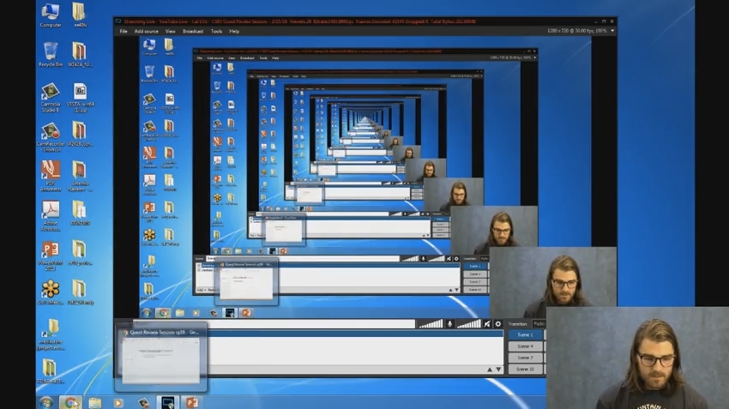
Trust …
The recursive “leap of faith” works as long as we hit the base case eventually
What happens if we don’t?
“Infinite Loop”

Slide 41
Example: infinite loop (recursion)
This code will never finish
def sum_recurse_inf_loop(n):
# base case
if n == 0:
return 0
# BUG: I forgot to do (n-1). Infinite loop!
return n + sum_recurse_inf_loop(n)
>>> sum_recurse_inf_loop(3)
Traceback (most recent call last):
File "C:\Users\Eric\c88c\lectures\lecture11\lecture11.py", line 96, in <module>
print(sum_recurse_inf_loop(3))
File "C:\Users\Eric\c88c\lectures\lecture11\lecture11.py", line 94, in sum_recurse_inf_loop
return n + sum_recurse_inf_loop(n)
...
[Previous line repeated 995 more times]
File "C:\Users\Eric\c88c\lectures\lecture11\lecture11.py", line 91, in sum_recurse_inf_loop
if n == 0:
RecursionError: maximum recursion depth exceeded in comparison
Aside: By default, Python has a maximum limit on how much recursive “depth” is allowed before it terminates the program.
If Python didn’t have this max limit, then our code would have run forever!
Or, to be more precise: eventually our CPU would run out of memory and crash. This is because function frames use up memory. Infinite call frames => infinite required memory => out-of-memory error.
To adjust max recursive depth limit, see: sys.setrecursionlimit()

Slide 42
Why Recursion?
“After Abstraction, Recursion is probably the 2nd biggest idea in this course”
“It’s tremendously useful when the problem is self-similar”
“It’s no more powerful than iteration, but often leads to more concise & better code”
“It’s more ‘mathematical’”
“It embodies the beauty and joy of computing”
…

Slide 43
(Aside) Tips for success
In my view, this class has suddenly increased in scope/difficulty.
Litmus test: at this point, we ideally expect you to be fairly fluent with Python:
Notably, be comfortable reading Python, writing Python from scratch, modifying existing Python
It’s OK if you you’re not there yet, but do keep this as your “north star”.
Programming is a craft you can only learn by doing (and not only by watching lectures or reading books/slides/etc).

Slide 44
(Aside) Tips for success
Warning: if you’re struggling with basic Python syntax, you are at risk of falling behind, as the rest of the course will continue rapidly building on top of Python.
Tip: If you’re feeling weak here, I’d prioritize getting comfortable with Python first before embarking on more complicated topics like recursion.
if you’d like, reach out on Ed for ideas on how to catch up!
# Write a function that, given a list
# of numbers, returns a new list with
# every number squared. Use a for-loop.
def square_nums(nums):
"""
>>> square_nums([2, 4, 5, 10])
[4, 16, 25, 100]
"""
out = []
for num in nums:
out.append(num ** 2)
return out
Litmus test: at this point, we expect you to be able to define this function on your own. Considered an “easy” problem.
Tip: If this doesn’t feel “easy” yet, practice until it does!

Slide 45
(Aside) Tips for success. Any questions?
Tip for success: deliberate practice, and being organized.
“Deliberate practice”: targeted practice on topics you know you aren’t comfortable with.
It’s not time-efficient to practice things you are already comfortable with.
Though, any practice is better than no practice. But, we don’t have infinite time/energy, so best use it strategically
Ex: “I know I’m not comfortable with recursion. Let me spend an hour doing recursion practice problems / asking my TA (or Ed) about this tricky recursion problem, etc.
“Being organized”: a surprising amount of success in this course (and, college/life in general) is keeping up with assignment due dates. Establish good organizational habits early!
“Meta learning”: aka “learning how to learn effectively”. Very important life skill.
At the end of the day, we (the teaching staff) want you to succeed!

